Slide 1
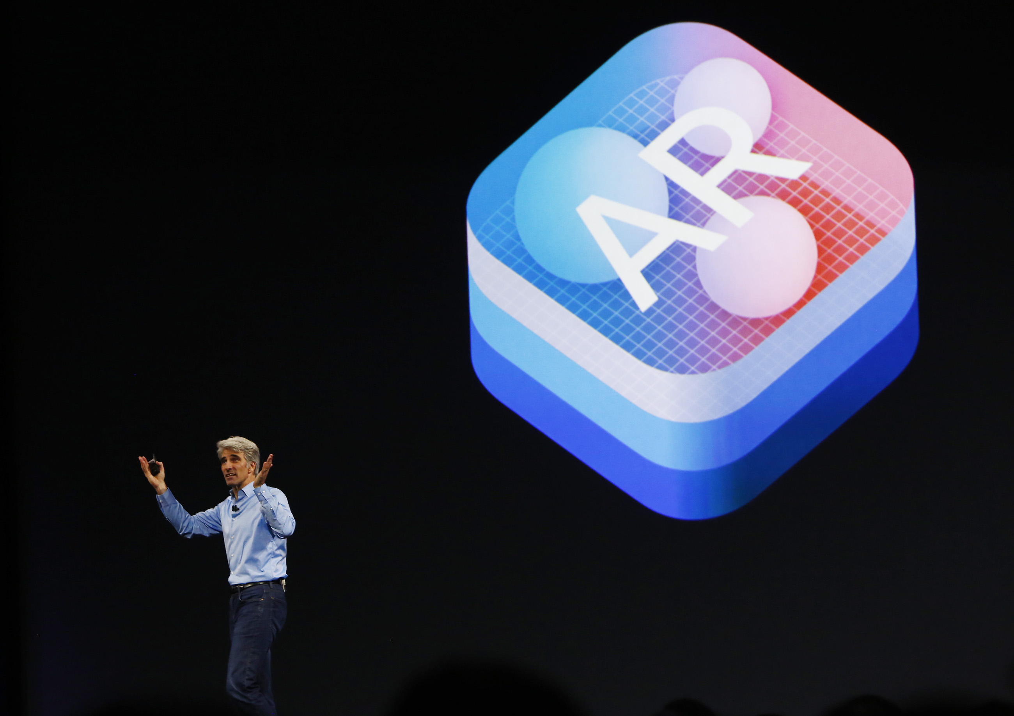
Augmented Reality

Slide 2
What is Augmented Reality
Augmented Reality is an interactive experience of a real-world environment where the objects that reside in the real world are enhanced by computer-generated perceptual information, sometimes across multiple sensory modalities, including visual, auditory, haptic, somatosensory and olfactory.

Slide 3
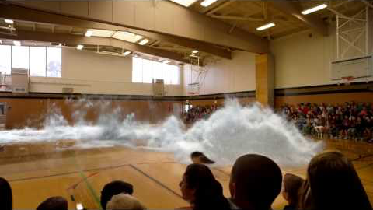

Slide 4
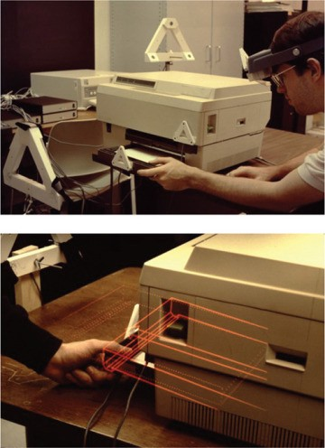
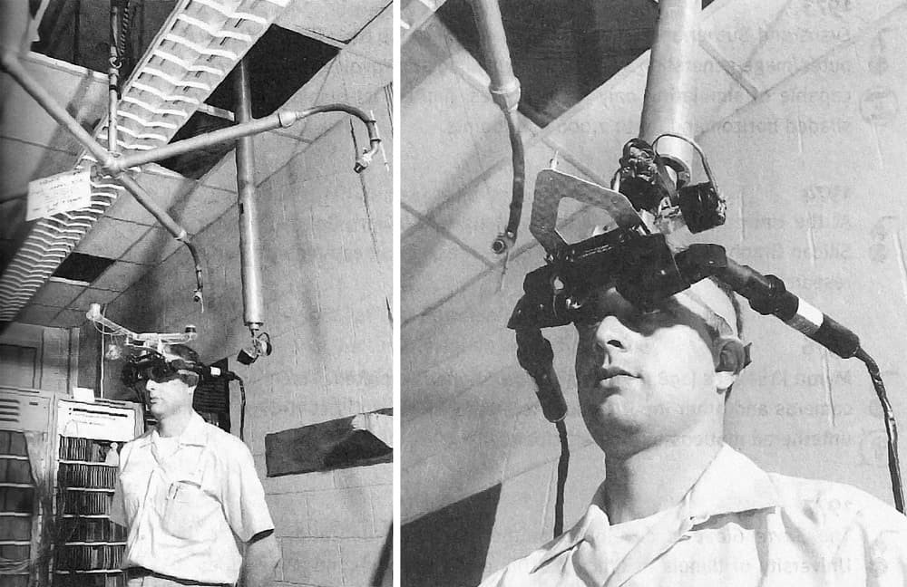
History of Augmented Reality
VR and AR were born! As theoretical concepts. It took a couple of decades for technology to catch up, and in the 1990’s AR found itself real-life applications for assisting workers with indoors assembly and maintenance.

Slide 5
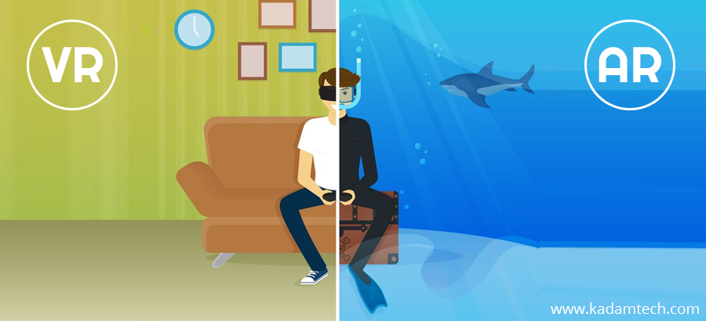
Difference between AR and VR
Virtual reality (VR) immerses users in a fully artificial digital environment. Augmented reality (AR)overlays virtual objects on the real-world environment. Mixed reality (MR) not just overlays but anchors virtual objects to the real world.

Slide 6
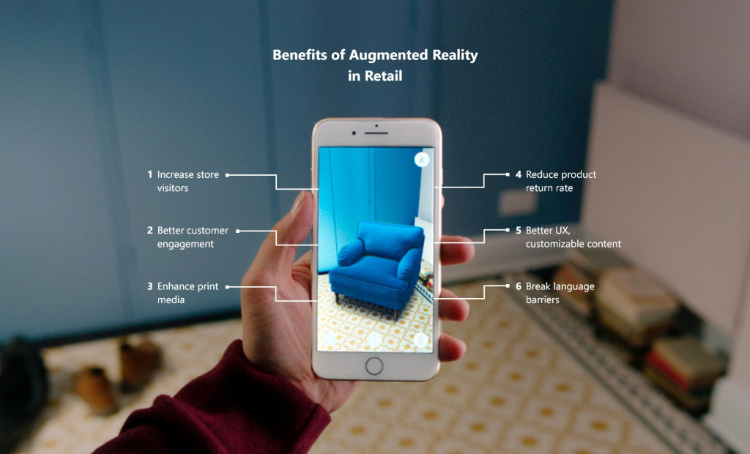

Slide 7
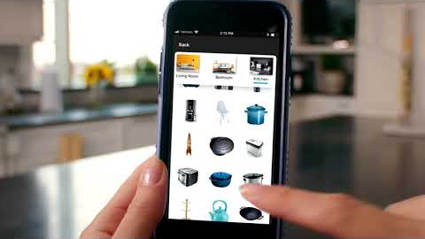
Introducing AR Amazon For Customers

Slide 8
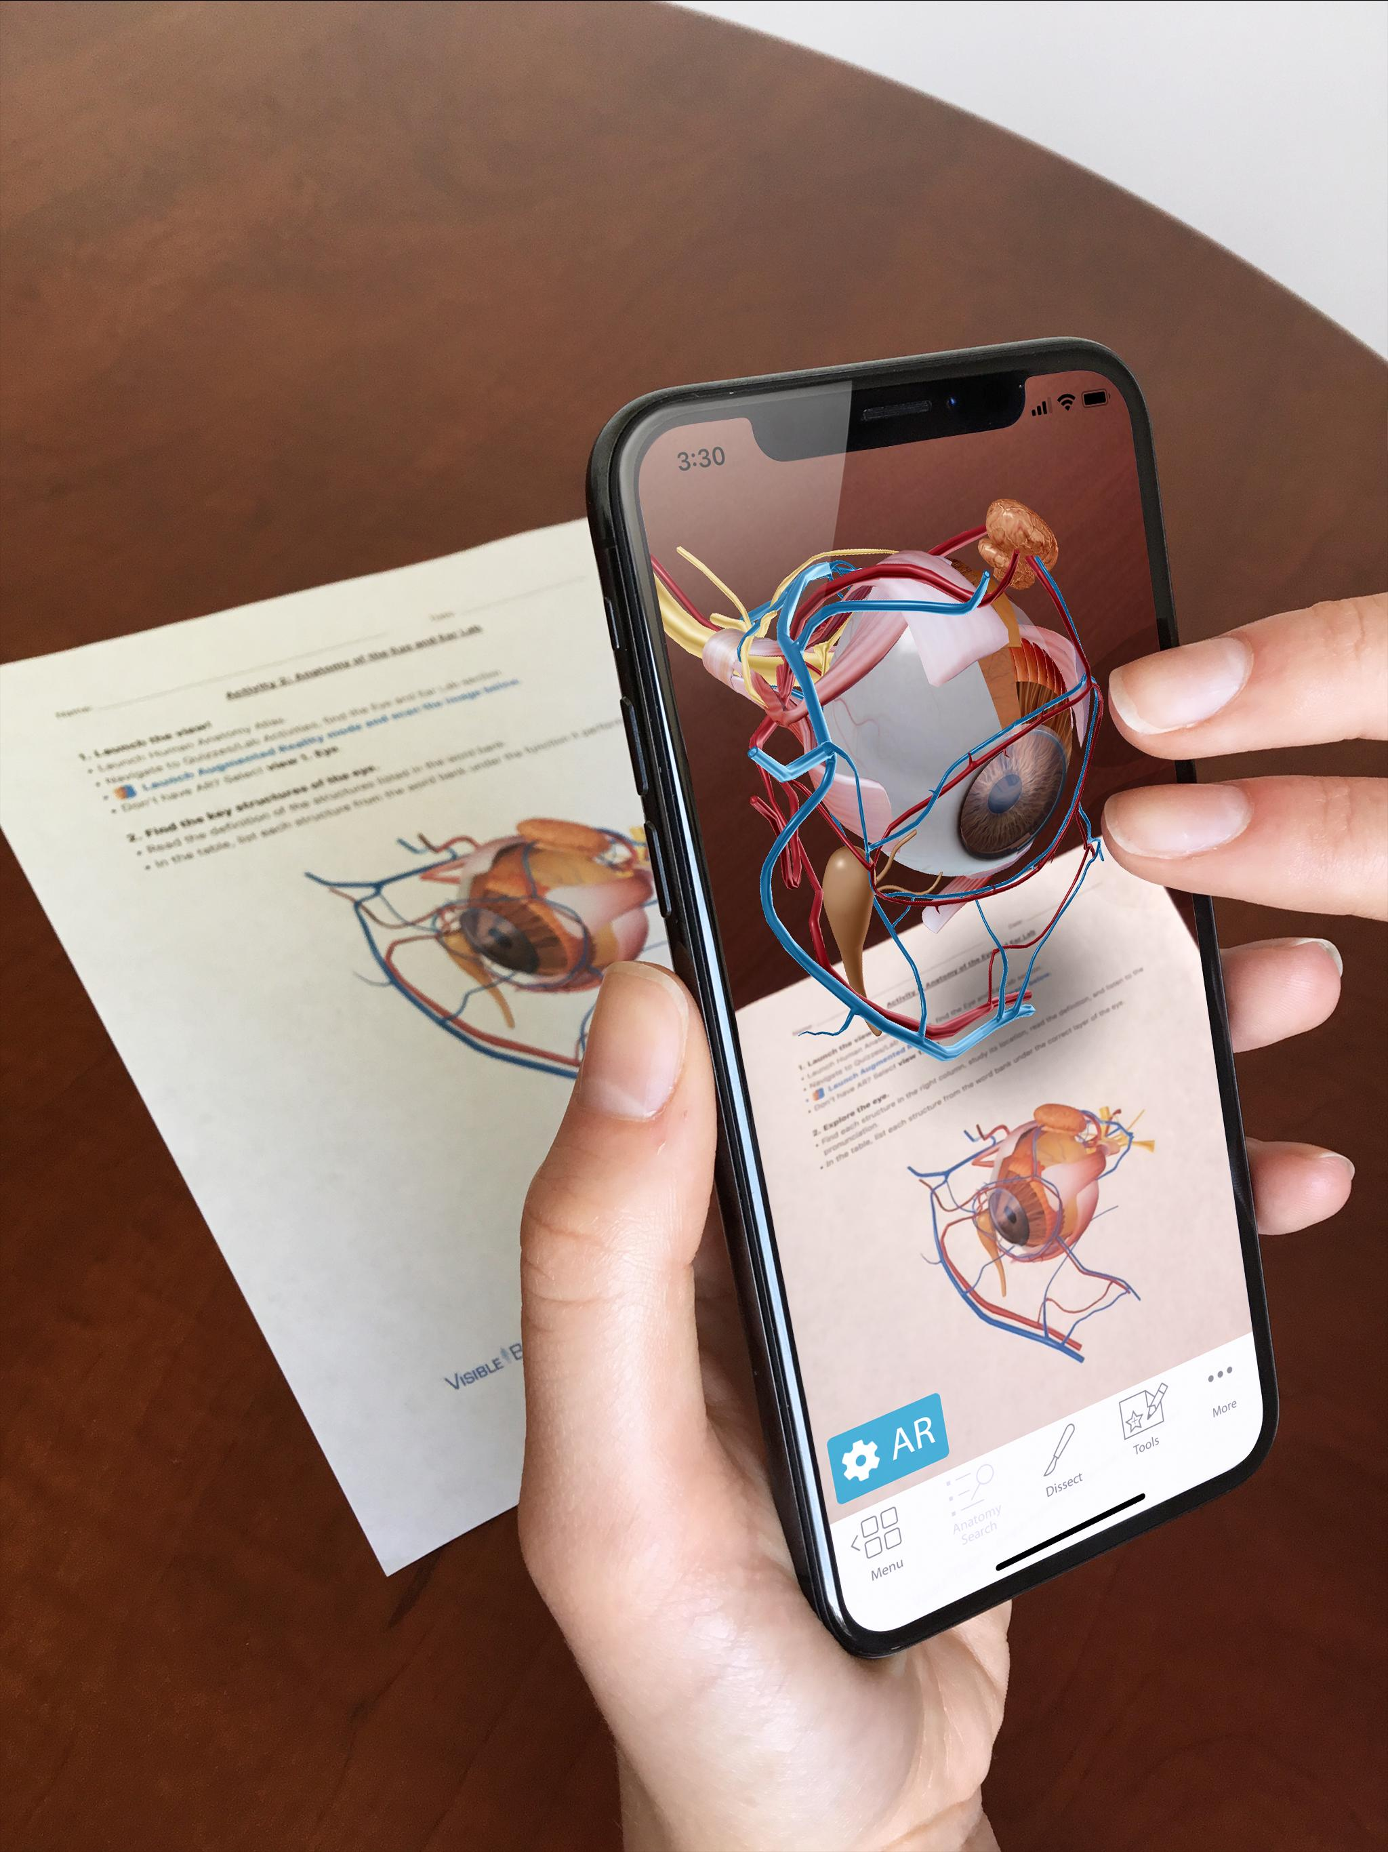
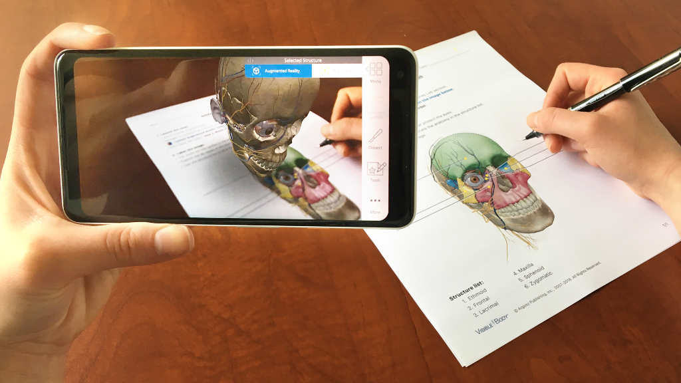
AR Use In Real World
1. Medical Training

Slide 9
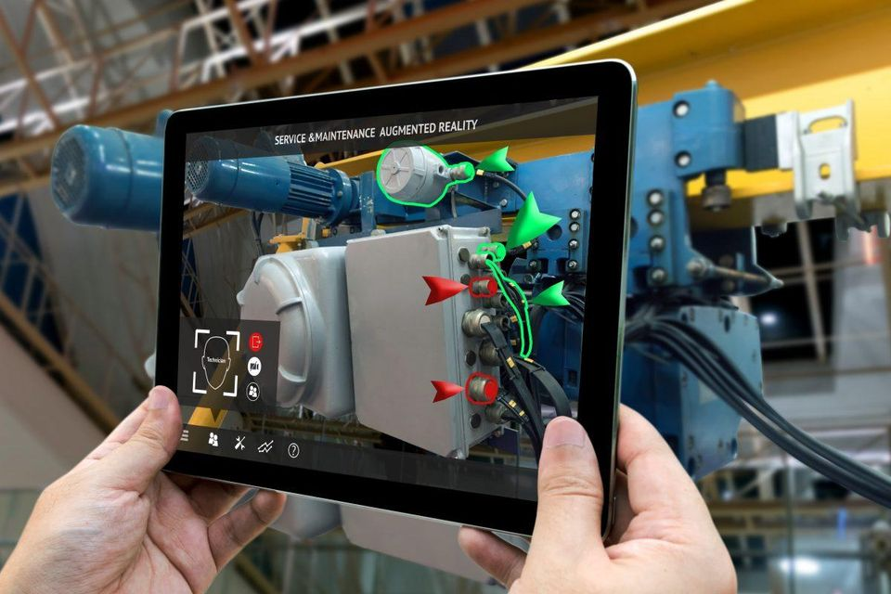
2. Service & Maintenance

Slide 10
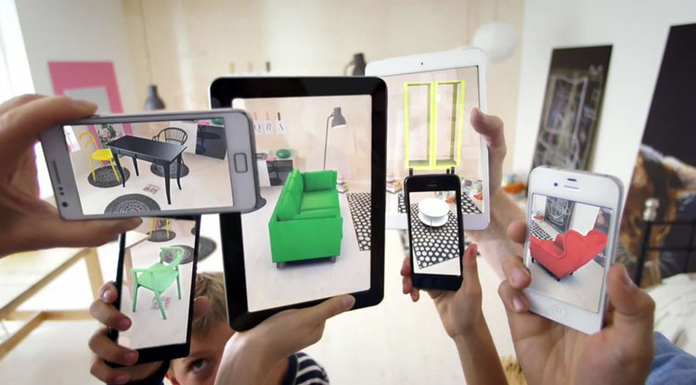
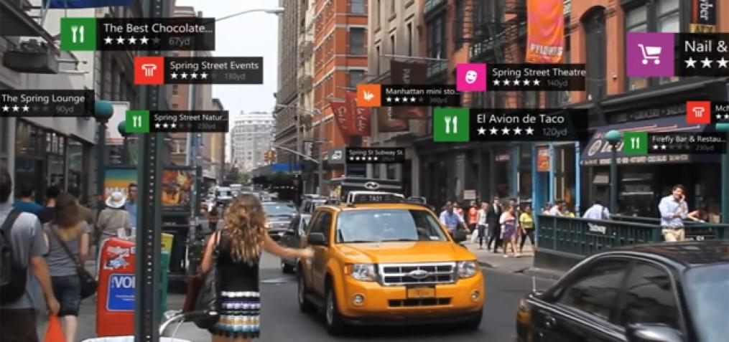
3. Business
4. Tourism Industry

Slide 11
Famours AR Apps in the world.

Slide 12
Tank you.

